Slide 1

CDSP Group #14 Communication Guideline

Slide 2
Contents
- Email Bulletins
- Infographics
- Intranet Pop-Ups
- Chatbot Quizzes
- Lunch 'n' Learn Materials
- Office Posters

Slide 3
Potential Companies For The Training
BMO
Scotiabank

Slide 4

Emails
A short staff email bulletins will be released that feature different linguistic features

Slide 5
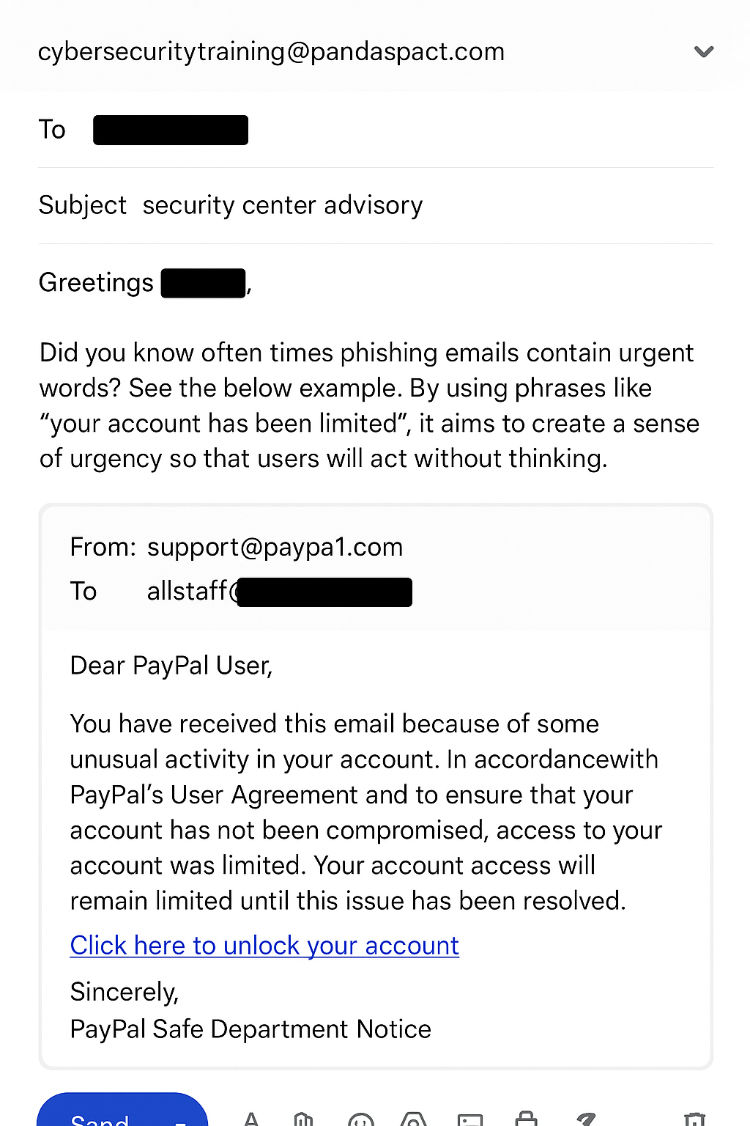
Email Bulletin — Urgency
Date to be posted: TBD | Target Persona: All Employees
Reason this email is phishing:
Urgency — creates pressure to act immediately.
Date to be sent - TBD
Persona targeted - Everyone
Goal - Teach about urgency in emails

Slide 6
Email Bulletin — Action
Date to be posted: March 10, 2025 | Target Persona: All Employees
Reason this email is phishing:
Action — prompts clicking, downloading, or logging in.
.
Note: Phishing emails usually combine multiple features for greater impact.

Slide 7
Email Bulletin — Reward
Date to be posted: March 10, 2025 | Target Persona: All Employees
Reason this email is phishing:
Reward — promises gifts, winnings, or bonuses.
Note: Phishing emails usually combine multiple features for greater impact.

Slide 8
Email Bulletin — Financial
Date to be posted: March 10, 2025 | Target Persona: All Employees
Reason this email is phishing:
Financial — mentions money, banking, or transactions.
Note: Phishing emails usually combine multiple features for greater impact.

